Slide 1
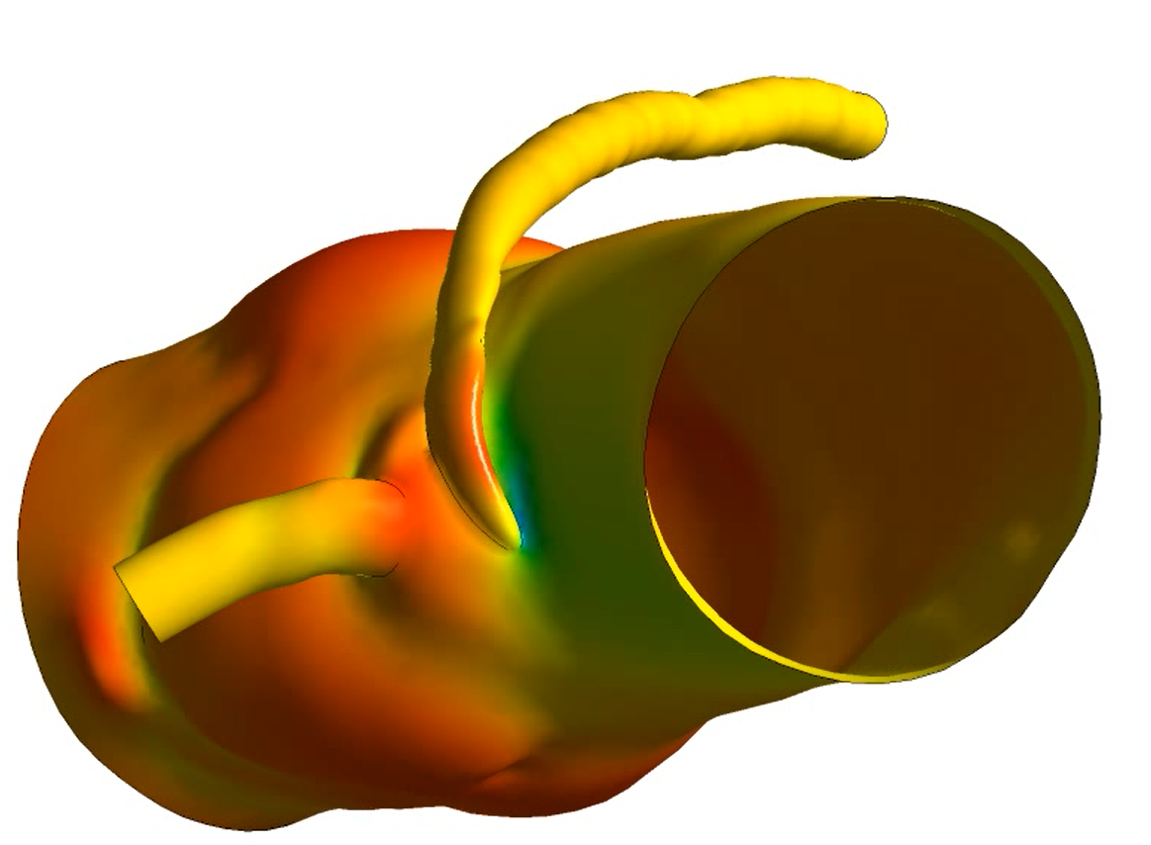
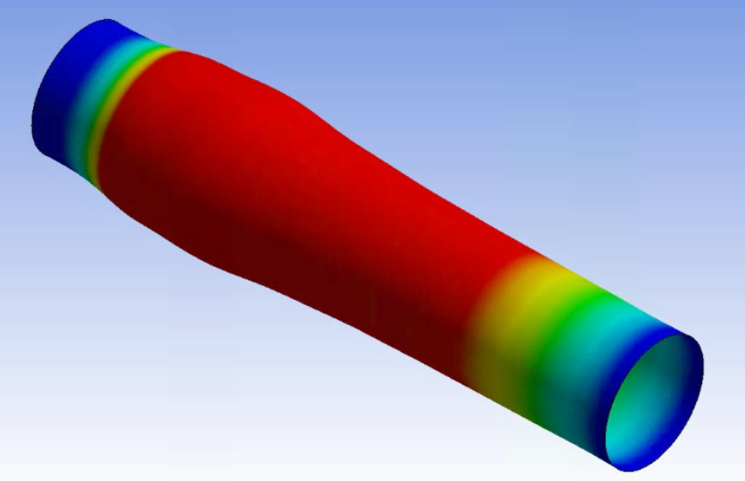
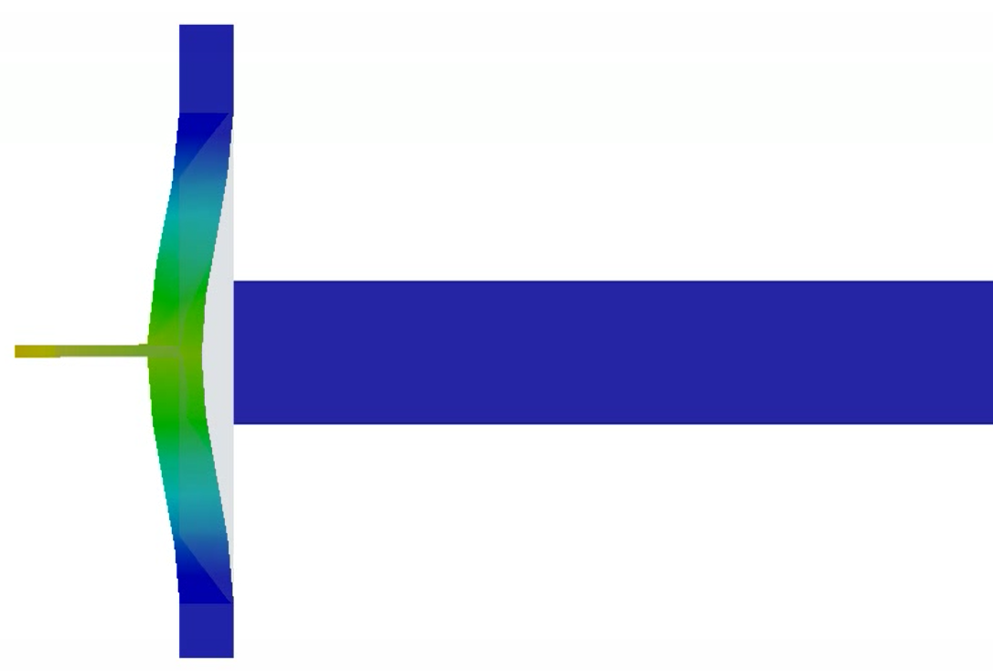
Università degli Studi di Pavia
Computational Mechanics & Advanced Materials Group - DICAr
Partitioned FSI for Modern Multiphysics Simulations
Multiphysics studies are playing a key role in today's engineering and scientific applications that can significantly impact the performance of various systems and devices. Computational Multiphysics simulations can be leveraged to provide invaluable insights that would help drive innovation forward and optimize efficiency and safety. The present seminar introduces the partitioned FSI (Fluid Structure Interaction) approach, a robust tool for tackling Multiphysics simulations. The interaction of a flexible structure with a contiguous fluid flow has been previously studied for several applications, such as flutter in aerospace engineering, cardiovascular disorder prediction in biomechanics, high-pressure safety valves. These studies prove the critical importance of Multiphysics simulations for predicting fluid properties such as the pressure difference, the flow rate, and structural properties like stress and displacement. We will walk through a step-by-step procedure and comprehensive workflow for developing an FSI model. To provide a practical context, we will be using the commercial software Ansys, a powerful tool that simplifies the implementation of the partitioned FSI approach. In addition, we will delve into the importance of FSI in modern engineering and scientific applications and discuss how to harness the power of such an approach to empower digital transformation.
SEMINAR
Ahmed Aissa Berraies
Computational Mechanics & Advanced Material Group
Department of Civil Engineering & Architecture, University of Pavia
17/07/2023, 14:00
Aula MS1, DICAr
Via Ferrata, 3 – Pavia
Notes:
1

